Slide 1
Test Taking
Chapter 7

Slide 2
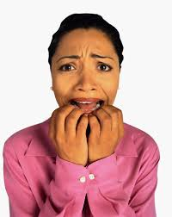
When it comes to test taking, I have trouble with . . . .

Slide 3
Strategies for Test Preparation

Slide 4
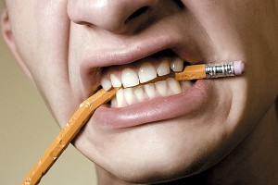
What doesn’t work in preparing for tests?
What has not worked well in the past?
Think about it.
Share your ideas with the person next to you.
Share with the class some of these ideas.

Slide 5
Preparation for exams begins the first day of class.

Slide 6
Preparation for exams begins the first day of class.
Attend class
Read the chapters. Use SQ4R.
Take notes and review them
Review periodically.

Slide 7
Manage Your Time
Schedule reading and review time.
Break it into small parts.
Use distributed practice.
Get started. Avoid procrastination.

Slide 8
Find a Time and Place to Study
Where do you study?

Slide 9


Test Review Tools

Slide 10
Flash Cards
Flash cards are an effective way to learn the details.
They are a great way to use distributed practice which is learning a little at a time.

Slide 11
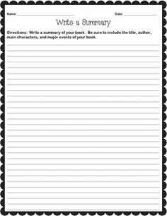
Summary Sheets

Slide 12
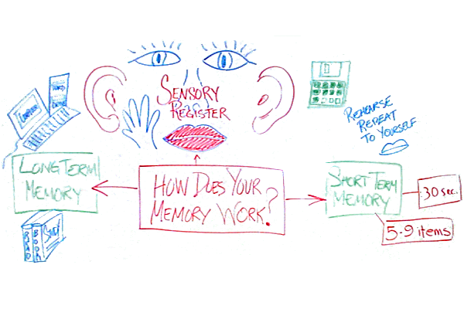
Mind Maps

Slide 13

Study Groups

Slide 14
How to Review Effectively
Immediate Review
Intermediate Review
Final Review
October

Slide 15

How to Predict the Test Questions

Slide 16
Ask About the Test
What does it cover?
What types of questions?
  True-false
  Multiple choice
  Essay

Slide 17
Predict Text Questions
Turn bold headings into questions.
Practice answering the questions.
If you are in a study group, assign each member to come up with practice questions to share with the group.

Slide 18
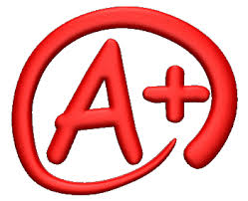
Use the first test as a guide on what to study on the next test.

Slide 19

Avoid Cramming!

Slide 20
Disadvantages of Cramming
Test anxiety
Poor use of mental ability
Performance suffers
You learn to dislike education
It is not fun
Within a week, you forget 75% of the material
It requires much effort and results in little benefit

Slide 21
Emergency Procedures
Cramming
Be selective.
Review and recite lecture notes first.
Skim and search each chapter.
Prepare summary sheets with key points.
Get enough rest.
Hope for the best.
Prepare in advance next time!

Slide 22

The Magical Seven Emergency Procedure
Start with 7 sheets of paper.
Write a key concept likely to be on the test at the top of each sheet.
Check your notes and text to write a definition, explanation or answer for each key topic.
Review and recite from the 7 sheets.

Slide 23

Dealing With Test Anxiety

Slide 24

Some anxiety is a good thing. It motivates you to study.

Slide 25
Grades just indicate how much or how well you studied for the test.
Be Successful by:
  Practicing relaxation techniques
  Being well-prepared

Slide 26

Relaxation Techniques

Slide 27

Do Some Physical Exercise
Exercise helps you to feel relaxed and energized

Slide 28

Get a Good Night’s Sleep
Lack of sleep interferes with memory
It may also make you tired and irritable

Slide 29

Take a Few Deep Breaths
Focus on your breathing to get your mind off the test

Slide 30

Visualize Your Success
While studying, picture yourself in the classroom doing well on the test

Slide 31

Admit to Yourself that You are Anxious
You can’t fight it.
You can’t deny it either.

Slide 32

Acknowledge your anxiety. Then focus on the test.

Slide 33
Do the Easy Questions First
This will help you relax
When you are relaxed, your brain works better.
You may find the answers on the test or something that triggers your memory so that you can answer the question.

Slide 34
Yell “Stop”
Interrupt your train of thought so you can get back to the test rather than focusing on your anxiety.

Slide 35

Daydream
Daydreaming may
help you to relax and
come back to the test
with a fresh attitude.

Slide 36
Practice Perspective
It is just a grade.
It is not the end of the world.
It does not define who you are.
Think about how you can improve your performance next time.

Slide 37
Think Positively
You may have a picture of failure in your mind as a result of past experience.
Notice your mental pictures about the subject you are studying.
Make a new mental picture of success if necessary.
The future can be different.

Slide 38

Does anyone have math anxiety?

Slide 39


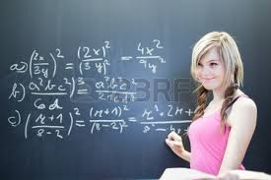
Start at the Beginning
Start at your skill level.
You may need to review if you have been out of school for awhile.

Slide 40

Don’t Delay Taking Math
You need math to graduate.
You need math to transfer.
You may need several math courses.
Many good paying jobs require math.

Slide 41

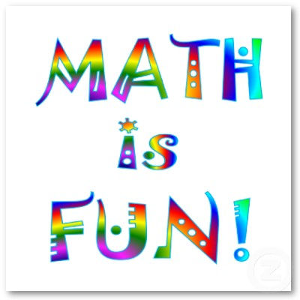
Think Positively About Your Ability to Succeed in Math

Slide 42

Get Help Early
Get tutoring if you get stuck.
Don’t wait!

Slide 43
Put in the Required Time
Remember that you will need about 10 hours a week to study math to be successful.
Being well-prepared reduces anxiety.

Slide 44

Don’t Miss Math Classes
It is difficult or impossible to catch up if you miss your math classes.

Slide 45

Do Your Homework Regularly
Practice until you feel confident.
You cannot cram for a math test.

Slide 46

Use a Study Group
Other students can help you to understand.
You can help others and increase your skill.
The study group can become a support group as well.

Slide 47
Math Success Formula
Hard Work
Experience
Confidence
Satisfaction
Success in Math

Slide 48
Rules for Success on Any Exam

Slide 49

Wake Up On Time or Early

Slide 50
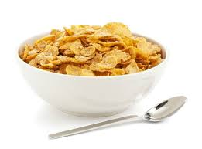
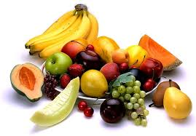
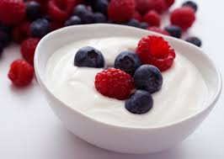
Eat a Light, Nutritious Breakfast

Slide 51

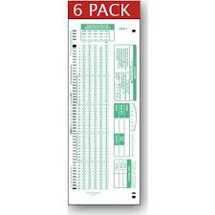
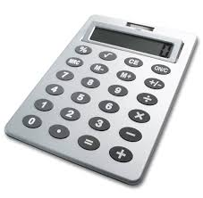
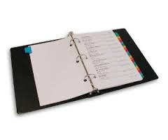
Bring the Proper Materials
Scantrons
Pencil, pen
Paper
Calculator

Slide 52

Arrive Early

Slide 53
Think Positively About the Exam

Slide 54
Read the Directions

Slide 55

Survey the Test Before You Start

Slide 56
Plan Your Time

Slide 57
Make Your Test Neat and Legible

Slide 58
Answer the Easy Questions First
This helps you to relax.
It builds your self-confidence too.

Slide 59
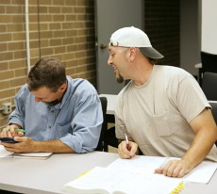
Be Careful Not to Give Any
Impression You are Cheating

Slide 60
Group Exercise:
Using a Study Group

Slide 61
Test Taking Techniques
Part II
Meet the Decoy

Slide 62
The Best Way to Prepare:
Study the key ideas
  Textbook
  Lecture notes
  Class handouts

Slide 63
Test Taking Techniques
Or how to guess if you need to
Or how to answer correctly after
you have studied

Slide 64

How To Take True-False Tests

Slide 65
How Does An Instructor Write a True False Question?
1. Find an important point
2. Write as is for true
3. Change or add a qualifier to make
it false

Slide 66
100% Qualifiers Make a Statement False. Why?
NO
NEVER
NONE
EVERY
ALWAYS
ALL
ONLY
ENTIRELY
INVARIABLY

Slide 67
These qualifiers are found in true statements. Why?
SELDOM
SOMETIMES
OFTEN
USUALLY
FREQUENTLY
MOST FEW
MANY SOME
GENERALLY

Slide 68
Tricky Questions
If any part of a true false statement is
false, the whole statement is false.
Good relaxation techniques include
deep breathing, exercise and
visualizing your failure on the exam.

Slide 69
Tricky Questions
Some tricky (usually false) statements
are composed of two sub statements
which are true and connected with a
conjunction such as:
THEREFORE
CONSEQUENTLY
AS A RESULT

Slide 70
Example
Martha does not have test anxiety,
and as a result makes good
grades on tests.
The second sub statement does
not follow logically from the first
statement.

Slide 71
Martha does not have test anxiety, and as a result makes good grades on tests.
This statement is false because she
also has to prepare for the exam. Not having test anxiety can even cause her to lack motivation to study.

Slide 72
Tricky Questions
Beware of double negatives.
No + No = Yes

Slide 73
Being prepared for the test is the best
way to earn good grades.
Not being unprepared for the test is
the best way to earn good grades.

Slide 74
Tricky Questions
If you have to guess, guess TRUE.
Most exams have more true questions.
Why?

Slide 75
The Multiple Choice Question

Slide 76
Begin With a True or False Question
Remember that multiple choice questions
are 4 true or false questions in a column.

Slide 77
How does the instructor write a multiple choice question?

Slide 78
Meet the Decoy

Slide 79
1. Look for an important point.
2. Make a stem.
3. Write the correct answer.
4. Think or 3 or 4 decoys.

Slide 80
EXAMPLE
Stem: In SQ4R, The 4R’S stand for:
1. Decoy
* 2. Read. Recite, review, reflect
3. Decoy
4. Decoy

Slide 81
Decoys are false statements.
Read all options. Determine which
statements are false and which are
true. Choose the BEST answer.

Slide 82
Tricky Questions
1. Watch for negatives and
100% qualifiers
2. Foolish options are generally
incorrect.

Slide 83
Example
The Cornell Format is:
A. A system for taking notes
B. A type of floor mat

Slide 84
Tricky Questions
All of the above is usually correct.
Answers in the middle range are
more likely to be correct.

Slide 85
Tricky Questions
Numbers in the middle range
are usually correct.
The Great Pyramid is ___ft. high.
A. 281
B. 381
C. 481
D. 981

Slide 86
Tricky Questions
Numbers in the middle range
are usually correct.
The Great Pyramid is ___ft. high.
A. 281 (low)
B. 381 (middle)
C. 481 (middle) (Correct answer)
D. 981 (high)

Slide 87
Who wants to be a millionaire?

Slide 88
$4000 Question: How many atoms of hydrogen are in a molecule of water?
A. 1 C. 2
B. 4 D. 6

Slide 89
$4000 Question: How many atoms of hydrogen are in a molecule of water?
A. 1 C. 2 (correct)
B. 4 D. 6

Slide 90
Tricky Questions
In look alike options, usually one is
correct and the other is a decoy.
The functional unit of the kidney
is the:
A. Pelvis
B. Nephron
C. Neuron
D. Medulla

Slide 91
Tricky Questions
In look alike options, usually one is
correct and the other is a decoy.
The functional unit of the kidney is the:
A. Pelvis
B. Nephron (look alike) (Correct)
C. Neuron (look alike)
D. Medulla

Slide 92
Who wants to be a millionaire?

Slide 93
$32,000 Question:
What president was known as the Great Communicator?
A. Reagan C. Johnson
B. Roosevelt D. Kennedy
Which answers look alike?

Slide 94
Reagan and Roosevelt look alike. Reagan is the correct answer.

Slide 95
Tricky Questions
Choose the option that is grammatically
correct.
Note:
Plurals
a/an

Slide 96
Tricky Questions
If you don’t know the answer, SKIP IT.
You may find the answer or something
that triggers your memory in the rest
of the test. Circle the ones you do not
know and come back to them later.

Slide 97
Tricky Questions
Choose the best or most complete
alternative.
When alternatives seem
equally good, select the longest one.
Why?

Slide 98
Tricky Questions
Whenever two of the options are opposites,
one is always wrong and the other is often,
but not always, right.
A decoy is a:
Right answer
Wrong answer
General qualifier
A true statement

Slide 99
Tricky Questions
Whenever two of the options are opposites,
one is always wrong and the other is often,
but not always, right.
A decoy is a:
Right answer
Wrong answer
General qualifier
A true statement

Slide 100
Ready for the “Guess” test?

Slide 101
Tips for Matching Exams
Read through both lists to discover patterns and relationships.
Count the items on each list. Are they equal?
First match the items you know for certain
Guess at the end, if you need to.

Slide 102
Tips for Sentence Completion Exams
Review facts such as definitions, names, places and dates
Use clues in the sentence to find an answer that makes sense in the sentence and fits the grammar of the sentence.

Slide 103
Essay Exams

Slide 104
The question should be answered directly in the first statement. Repeating part of the question is a good way to stay on track.

Slide 105
Tips
Manage your time so that you complete all the questions needed.
Read the directions.
Make sure you understand the question.
Jot down memory aids.
Use good writing, grammar and spelling.
Write neatly!

Slide 106
Tips
Never leave a question blank. Write down what you know. You may get partial credit.

Slide 107
Words to watch for in essay questions

Slide 108
Words to watch for in essay questions
illustrate
analyze
enumerate
outline
describe
demonstrate
compare
explain
trace

Slide 109
Words to watch for in essay questions
define
contrast
diagram
discuss
justify
relate
compare
summarize
evaluate

Slide 110
Let’s try a short essay on test preparation.

Slide 111
Let’s Warm Up for the Essay:
How to Prepare for Exams
Intellectually
Emotionally
Physically

Slide 112
Exercise:
Practice with Short Essays

Slide 113
Machine-graded tests
The answer you mark must correspond to the question
Do not make stray marks on the answer sheet

Slide 114
Open-book tests
Write down formulas.
Place post-it notes or paper clips on important pages.
Number your class notes and write a short table of contents.

Slide 115

Math Tests
Check your work.
Do the first step again.
Estimate your answer.
Is the solution logical and does it make sense?
Check for careless errors.
Get enough sleep.

Slide 116

When tests are returned:
Use them as feedback for future study
  Do you need to improve your study techniques?

Slide 117
Keys To Success:
Be Prepared

Slide 118
Success
Begins with a vision of the future
Becomes reality through hard work and preparation

Slide 119
I’m a great believer in luck, and I find the harder I work, the more I have of it.
Thomas Jefferson

Slide 120
Remember, good test preparation begins the first day of class.

Slide 121
Good Preparation is the Key to Success in Many Areas of Life
Tests
Making a business plan
Going on vacation
Having a wedding
Building a house

Slide 122
Exercises:
Test Taking Checklist
Analyze Your Test Taking Skills

